Slide 1

Country Report Italy
Nicola Pierro, Maria Teresa Petrone
Isabella De Bari*, ENEA
Italy, November 2022
*Italian Team Leader IEA Bioenergy Task42

Slide 2
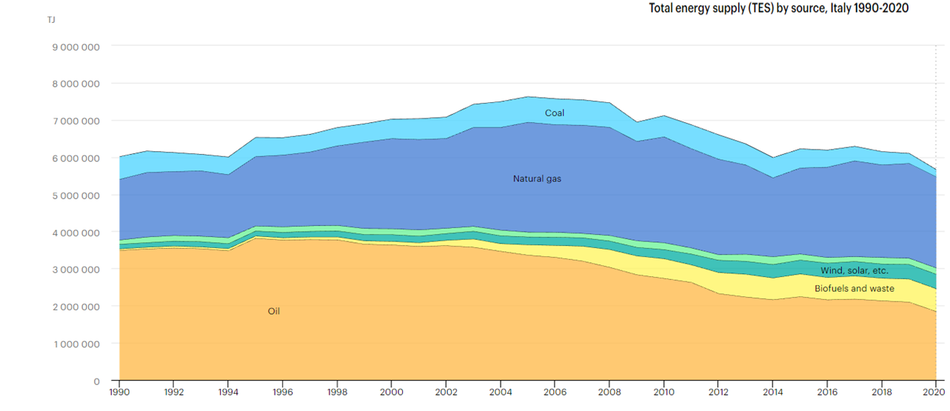
Energy System Overview
Last Update 2020
TPES
137.98 Mtoe
Energy Production
35.2 Mtoe
Net Energy Import
105.4 Mtoe
TPES by source (%)
Oil | 32%
Natural Gas | 44%
Coal | 3%
Hydro | 3%
Wind, Solar, etc. | 7%
Biofuel and waste | 11%
Total energy supply (TES) by source, Italy 1990-2020
The share of overall energy consumption covered by RES in 2020 is 20,4 %
(for the 7th consecutive year above the 2020 target set for Italy = 17%)
Source: GSE Statistical Report 2020
www.iea.org

Slide 3
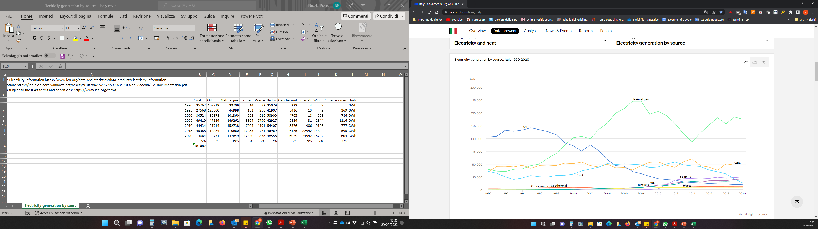
Electricity Generation and Consumption
Last Update 2020
Gross electricity production
281.5 TWh
Share of RES (Gross RES production)
Hydro | 41%
Solar | 21%
Bioenergy | 17%
Wind | 16%
Geothermal | 5%
Electricity final consumption
302.75 TWh
Share of RES
41.7%
Total CO₂ emissions
280.4 Mt of CO₂
Electricity generation by source, 2020 (GWh)
Coal | 13.064
Oil | 9.771
Natural gas | 137.649
Biofuels | 17.330
Waste | 4.838
Hydro | 48.558
Geothermal | 6.029
Solar PV | 24.942
Wind | 18.702
Other sources | 604
Electricity generation by source, Italy 1990-2020
Bioenergy Electricity Prodution
Solid Biomass + Waste | 6,8 TWh
Biogas | 8,2 TWh
Bioliquid | 4,7 TWh
RES-E penetration in 2020 is 41,7 %
(A growth of 0,9% compered to 2019, is due principally to Solar +5.3% & Hydroelectric +2.7%, that compensates the loss of Wind -7.1% )
Source: GSE Statistical Report 2020
www.iea.org

Slide 4
Biofuels for Transport
Last Update 2021
Biofuels consumption for transport - 2021
 | ktoe | %
Biodiesel/green diesel | 1388 | 89,4 %
Bioethanol | 0 | 0 %
Bio-ETBE | 27 | 1,7 %
Biomethane | 137 | 8,8%
TOTAL | 1552
Biofuels consumption
1.55 Mtoe – 1719 ktons
Biomethane consumption
137 ktoe – 116 ktons
RES-T penetration in 2020 is 10.7 %, higher than the 10% target set for the 2020
Source: GSE Energia nel settore Trasporti 2005-2021

Slide 5
Biofuels for Transport
Last Update 2021
Contribution of renewables in the transport sector in 2021, according to the criteria defined in RED I for calculating the obligations for fuel and electricity suppliers (ktoe)
 | Multiplication factor * | ktoe | Contribution % Applying multiplication factor
Numerator |  | 3526
Renewable share of electricity for road transport | x 5 | 13,2 | 2%
Renewable share of electricity for rail transport | X 2,5 | 165 | 12%
Renewable share of electricity for other transport | 1 | 156 | 4%
Biofuel Double Counting | X 2 | 1338 | 76%
Biofuel Single Counting | X 1 | 214 | 6%
Denominator – Gross final consumption in the transport sector |  | 32307
RES-T share (%)– RED I |  | 10,9%
* The contributions of the individual components are shown without applying the multiplication factors. The overall numerator, however, is obtained taking the multipliers into account.
Source: GSE Energia nel settore Trasporti 2005-2021

Slide 6
Biofuels for Transport
Last Update 2021
Biofuels released for consumption in Italy in 2021 by country of production
Biofuels released for consumption in Italy in 2021 by country of origin of the raw material
 | Total (ktoe) | Total (%)
Italy | 583 | 36,2%
Spain | 422 | 27,8%
Netherlands | 97 | 6,4%
Bulgary | 88 | 5,8%
UK | 64 | 4,2%
Austria | 61 | 4,0%
France | 56 | 3,7%
Germany | 53 | 3,5%
Czech Republic | 38 | 2,5%
Argentina | 35 | 2,3%
Denmark | 32 | 2,1%
Other Country | 23 | 1,5%
 | Total (ktoe) | Total (%)
Cina | 317 | 20,8%
Indonesia | 257 | 16,9%
Italy | 218 | 12,2%
Spain | 121 | 8,0%
Malaysia | 92 | 6,1%
UK | 60 | 3,9%
France | 58 | 3,8%
Angertina | 49 | 3,2%
Germany | 33 | 2,1%
Denmark | 22 | 1,4%
Austria | 21 | 1,4%
Other EU | 154 | 10,1%
Other Country | 150 | 9,9%
36,2 % of total biofuels released for consumption in Italy in 2021 are produced in Italy
Only the 12,2% of total biofuels released for consumption in Italy in 2021 was produced from raw materials of national origin.
Overall, 43% of the raw materials used come from European countries (EU27 + UK).
Source: GSE Energia nel settore Trasporti 2005-2021

Slide 7
Biofuels for Transport
Last Update 2021
Feedstocks used for Biofuels released for consumption in Italy in 2021
1. Biofuels Single Counting
2. Biofuels Double Counting – Not Advanced
 | Biodiesel | Bio-ETBE | Bioethanol | Biomethane
Palm tree | 62,1% | - | - | -
Soy | 28,9% | - | - | -
Corn | - | 89,8% | 100% | -
Rapeseed | 6,0% | - | - | -
Derived from the processing of vegetable oils | 2,8% | - | - | -
Wheat | - | 5,4% | - | -
Barley | - | 4,8% | - | -
Animal by-products (ABPs) | - | - | - | 100%
Sunflower | 0,1% | - | - | -
 | Renewable diesel
UCO - Used Cooking Oil | 51%
Animal Fat | 49%
Source: GSE Energia nel settore Trasporti 2005-2021

Slide 8
Biofuels for Transport
Last Update 2021
Feedstocks used for Biofuels released for consumption in Italy in 2021
Data need some check of the sources
3. Advanced Biofuels Double Counting
 | Biodiesel | Bioethanol | Biomethane
Palm oil mill effluent (POME) | 54,73% | - | -
Agro-industrial waste and other waste | 44,81% | - | 4,59%
OFMSW | 0,01% | - | 77,02%
Animal manure and sewage sludge | - | - | 9,29%
Other cellulosic materials of non-food origin | - | - | 3,09%
Biomass fraction corresponding to unsorted municipal solid waste | - | - | 1,92%
Grape marc/Wine lees | - | 100% | 1,70%
Tall oil | 0,38% | - | -
Bacteria | - | - | 1,27%
Straw | - | - | 0,99%
Algae | 0,06% | - | -
Rice husk | - | - | 0,11%
Corn cobs | - | - | 0,003%
Source: GSE Energia nel settore Trasporti 2005-2021

Slide 9
Biofuels for Transport
Last Update 2021
Bioethanol in Italy
The quantity of bioethanol released for consumption in Italy in 2021 was
75 tons
60 tons
Produced in Other Country
Feedstock is Corn, produced in Austria
15 tons
Produced in Italy
Feedstock is Grape marc/Wine lees, produced in Italy
Bioethanol released for consumption in Italy (tons), 2015 - 2021
Source: GSE Energia nel settore Trasporti 2005-2021

Slide 10
Biofuels for Transport
Last Update 2021
Advanced Bioethanol Plants in Italy
Caviro Extra (Faenza, RA)
Production Capacity: 71 ktons/year
Feedstock: Grape marc/Wine lees
Eni - Versalis (Crescentino, VC)
Production Capacity 40 ktons/year
Feedstock: Straw
At the beginning of February 2022, bioethanol production restarted. Currently the plant is able to treat 200 ktons/year of biomass, for a maximum production capacity of about 25 ktons of bioethanol per year (Source: www.eni.it)

Slide 11
Bioeconomy in Italy
364.3 billion € overall value of production for over 2 million employees in 2021 (19.4 % of the national GDP)
Key sectors | Value of production (milion of €) | Share (%) | Employees (thousand person) | Share (%)
Agriculture, forestry and fisheries | 63 154 | 17.4 | 928 | 46.1
Food industries , beverages and tobacco | 153 131 | 42.1 | 468 | 23.2
Textiles bio-based | 9 919 | 2.7 | 52 | 2.6
Bio-based clothing | 15 050 | 4.1 | 97 | 4.8
Tanning and leather goods / footwear bio-based | 17 328 | 4.8 | 81 | 4.0
Wood and products of wood | 16 808 | 4.6 | 102 | 5.1
Paper and paper products | 27 494 | 7.6 | 68 | 3.4
Biobased chemicals | 6 268 | 1.7 | 10 | 0.5
Biobased pharmaceutical products | 15 083 | 4.1 | 36 | 1.8
Biobased rubber plastic | 1 607 | 0.4 | 6 | 0.3
Bio-based furniture | 12 361 | 3.4 | 63 | 3.1
Bioenergy | 3 381 | 0.0 | 2 | 0.1
Biofuels | N.A. | N.A.
Water cycle | 13 502 | 3.7 | 51 | 2.5
Biodegradable waste management and recovery | 9 189 | 2.5 | 49 | 2.4
Total Bioeconomy | 364 275 | 100 | 2 013 | 100
EMERGING SECTOR
Source: «La Bioeconomia in Europa» 8° Rapporto Intesa San Paolo - Assobiotech

Slide 12
Policy Document
The National Recovery and Resilience Plan (NRRP)
The exploitation of RES/waste is part of the MISSION 2 of the National Recovery and Resilience Plan
MISSION 2 - Green revolution and ecological transition
Component 1: Sustainable agriculture and circular economy
Component 2: Renewable Energy, Hydrogen, Network and Sustainable Mobility
Areas of intervention
efficient and
sustainable management of waste and circular
Economy
Develop a sustainable supply chain
Increase the share of energy produced from renewable sources
Increase the share of energy produced from renewable sources
Support startups and venture capital active in the ecological transition
1.5
€bn
0.6
€bn
0.5
€bn
1.1
€bn
1.92
€bn
0.16
€bn
0.5
€bn
0.5
€bn.
Promoting the transfer of research into innovative patents and businesses
New waste management facilities and existing modernization
Circular Economy "Lighthouse" Projects
Innovation and mechanization in the agricultural and food sector
Agro-voltaic development
Biomethane development
R&D on Hydrogen
H2 production on abandoned industrial areas
Source: Italian NRRP

Slide 13
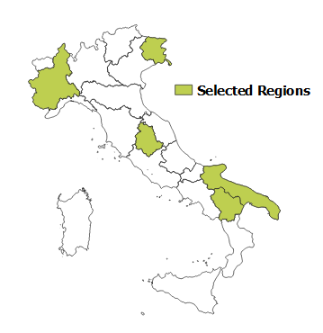
Policy Document
The National Recovery and Resilience Plan (NRRP)
MISSION 2 - Component 2: Renewable Energy, Hydrogen, Network and Sustainable Mobility
Increase the share of energy produced from renewable sources
H2 production on abandoned industrial areas
Create 10 hydrogen valleys, or rather, in order to promote, at the local level, the production and use of H2 in industry and transports. Instruments and tools for the production of hydrogen thanks to RES will be installed specifically in brownfield areas which are already connected to the electrical grid.
Next Steps
By March 2023 adjudication of hydrogen producing projects in abandoned industrial areas
By June 2026 completion of 10 projects with a capacity of the least 1-5 MW each
Piedmont, Friuli-Venezia-Giulia, Umbria, Basilicata and Puglia have chosen to select “Hydrogen Valleys” as the flagship project under the NRRP.
Source: Italian NRRP

Slide 14
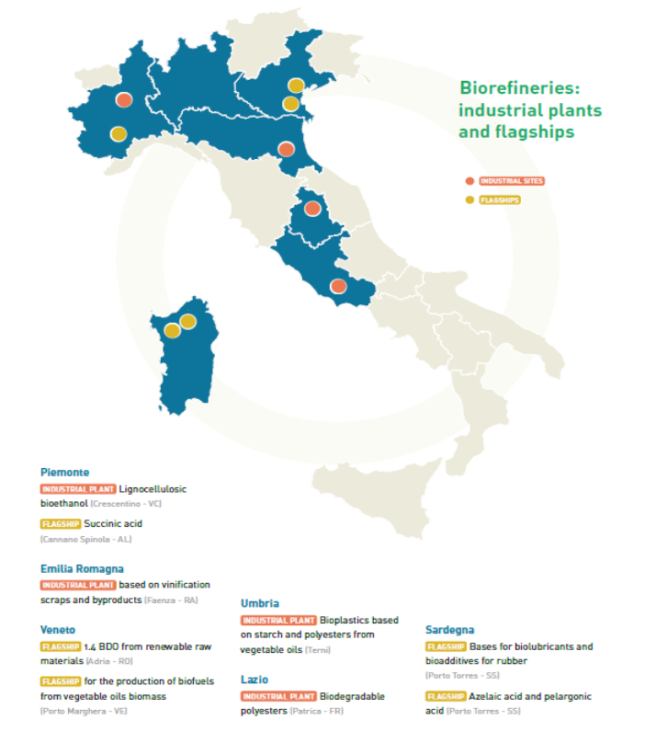
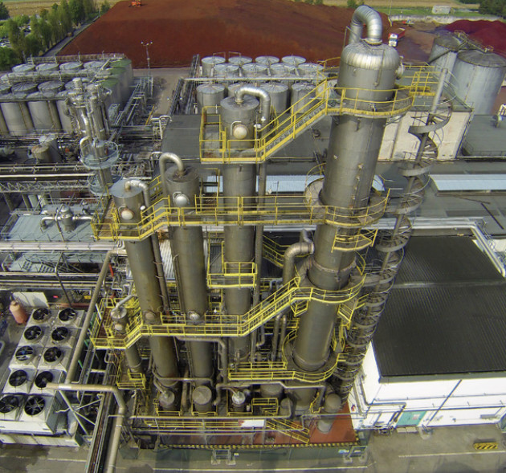
Industrial Biorefineries
Map of industrial plants
Mater-Biopolymer (Patrica, FR) INDUSTRIAL
Products Origo-Bi®
Capacity 100 ktons/year
Novamont (Terni, TN) INDUSTRIAL
Products Biolubricants and bioplastics from local crops
Capacity 20 ktons/year –compounding; 60 ktons/year -polyesters
Eni - Versalis (Crescentino, VC) INDUSTRIAL
Products Bioethanol
Capacity 40 ktons/year
Caviro Extra (Faenza, RA) INDUSTRIAL
Products Bioethanol, Ethyl alcohol, Biogas
Capacity 71 ktons/year
ENI (Gela, CL) INDUSTRIAL
Products Hydrotreated vegetable oils (based on Ecofining™ technology)
Capacity 720 ktons/year max capacity; 600 ktons/year HVO production
Source: BIT II

Slide 15
Industrial Biorefinery Plants
Reverdia (Cassano Spinola, AL) FLAGSHIP
▪ Products Succinicacid
▪ Capacity 10 ktons/year
Mater-Biotech (Bottrighe, RO) FLAGSHIP
▪ Products 1.4 BDO
▪ Capacity 30 ktons/year
ENI (Porto Marghera, VE) FLAGSHIP
Products HVO (green-diesel, green-naphtha and green-gpl)
Capacity 560 ktons/year at 2024 (currently about 360 ktons/year) with a production of about 420 ktons/year of total HVO (currently about 300 ktons/year)
Matrìca(Porto Torres, SS) FLAGSHIP
▪ Products Biolubricants, Bioadditives, Azelaicacid, Pelargonicacid
▪ Capacity 350 ktons/year
Source: BIT II

Slide 16
Projects of Significant National Interest for Hydrogen and biofuels
NEXTCHEM + ENI
EDISON + ANSALDO ENERGIA + ENI
Waste to Hydrogen plant in Porto Marghera (Venice, Italy)
Waste to Methanol plant in Livorno (Italy)
Production of Green/Blue hydrogen for use in place of methane in Edison’s new power station in Porto Maghera.
Installed capacity 780MW
ENI
ENEA
Waste to Fuel: bio-oils production from the Organic Fraction of Municipal Solid Waste, Pilot plant in Gela (Italy)
ENEA Casaccia Hydrogen Valley: the research center will also allow the test of new technologies for the production of hydrogen, for example, through the use of waste and the use of renewable medium-high temperature heat produced by concentrating solar plants

Slide 17
Projects of Significant National Interest
ENI Ravenna Hub (North Italy) - CO₂ storage site
This hub aims to become the reference hub for Italy and the Mediterranean.
The plan is to launch phase 1 in 2023, testing technologies in a full capture, transport and storage chain handling up to 100,000 tons per year.
Phase 2, scheduled to start in 2027, will allow storage of 4 million tons of carbon dioxide per year, about half of it from three power stations and a hydrogen plant owned by Eni, and the rest from other emitters
Storage will be in offshore depleted gas reserves in the Adriatic Sea. Total storage resource in the Adriatic is estimated at 500 million tons.
Source: www.eni.it
The CCUS Hub

Slide 18
For more information, please contact us at:
isabella.debari@enea.it
ENEA Trisaia Research Centre
Bioenergy, Biorefinery and Green Chemistry Division
SS 106 Jonica km 419+500
75026 Rotondella (MT)

